Slide 1
WebDev Final Portfolio Storyboard
Kyle Samson, w0265131, 703

Slide 2
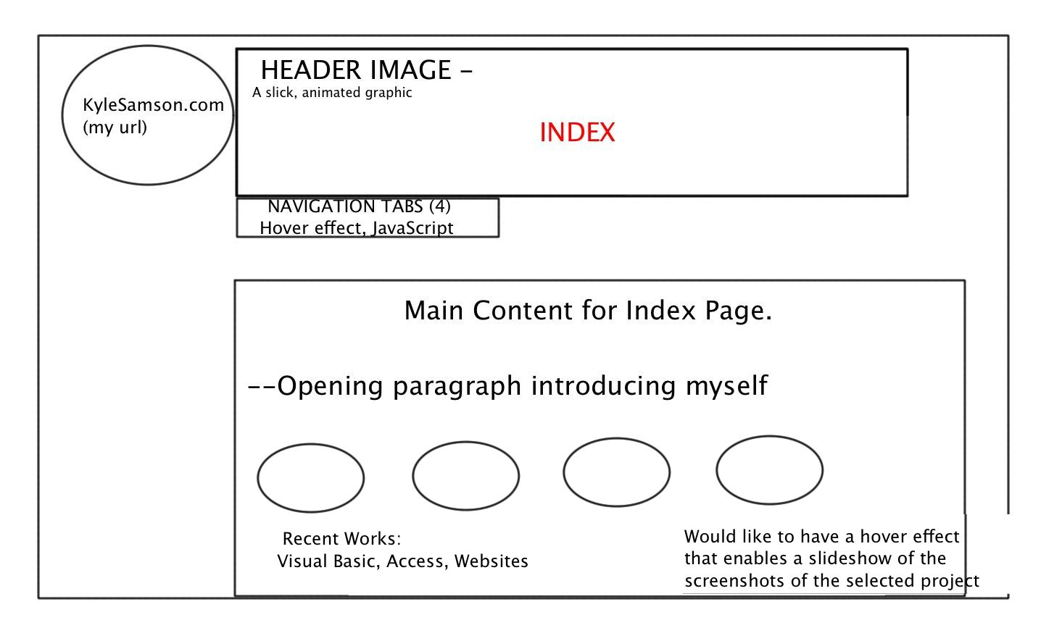

Slide 3
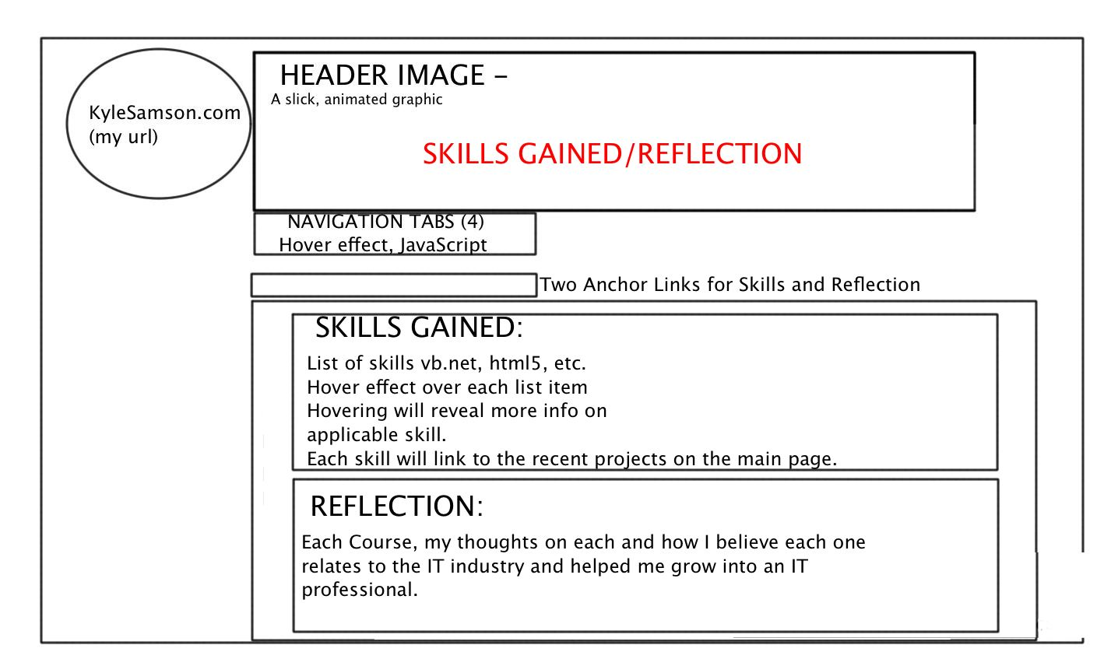

Slide 4
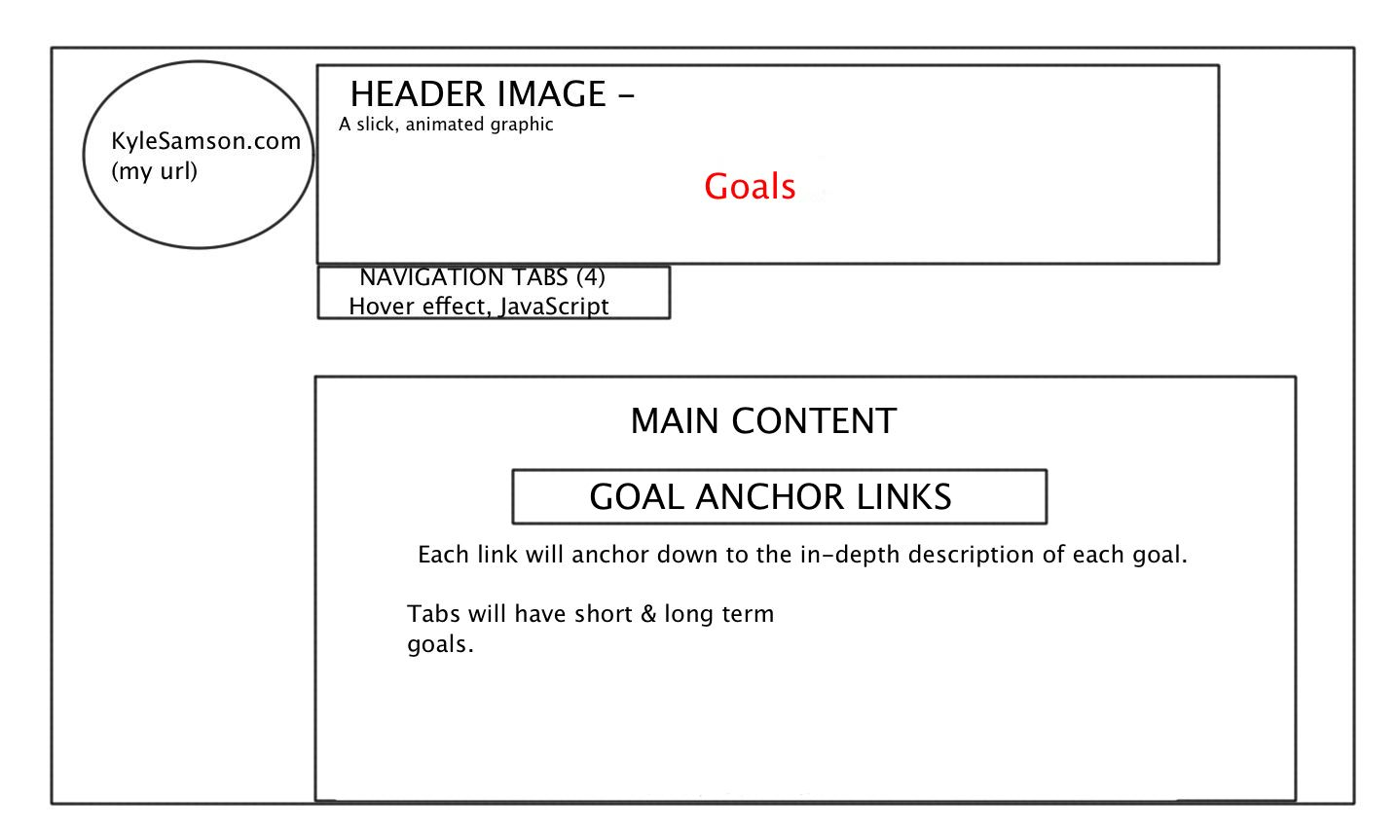

Slide 5
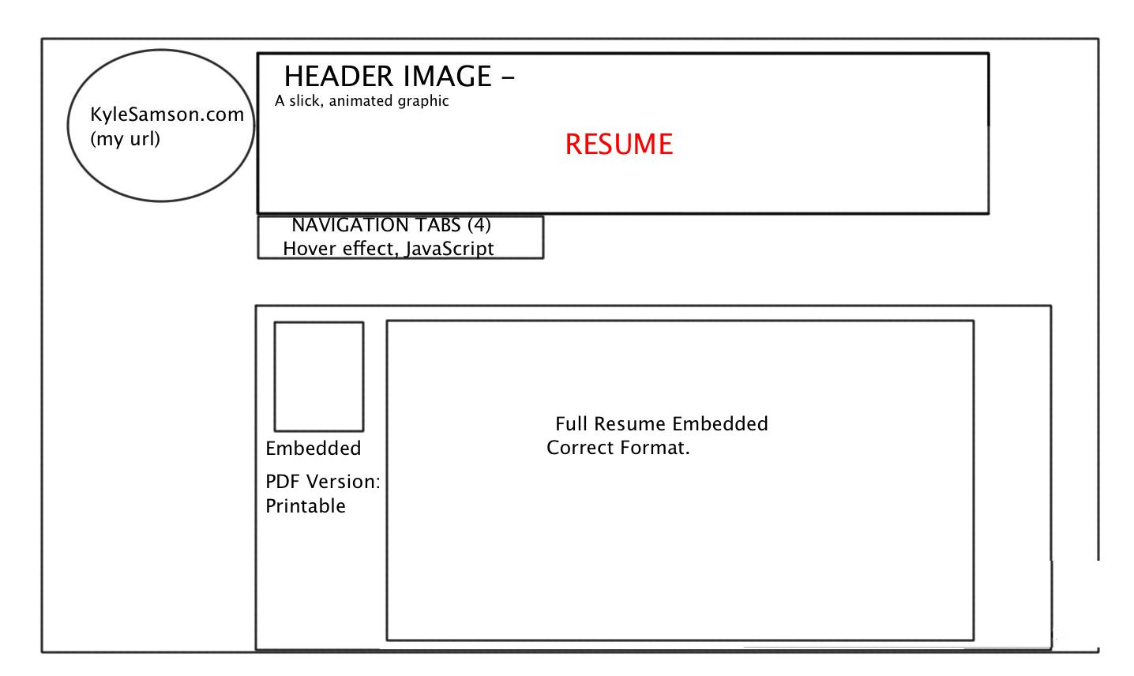

Slide 6
